Slide 1

Welcome!
I am ________
Senior Datawarehouse Engineer
@.
Linkedin: @

Slide 2
Introduction to Programming

Slide 3
What Why How?

Slide 4
Print Statement
We use print statement to see the result/output of the processing that we write code for to see whether the code is producing the output that we need or not.
It helps in printing user friendly messages to end users.
In real world applications User Interface is used instead of print statement to have better user experience for end users who don’t know about programming or terminals.
Always use print statement whenever you need to understand the code at each step.

Slide 5
Variables and Data Types
Data Type → Silver
Bank Account/Locker:
If we open a dollar account in any bank or we get a locker where we can put our gold or silver & we can put any amount or quantity in those, then:
            The locker or account → Variable
            Type of thing we keep in → Data Type
            The limit or physical size of the account/locker → Size of the Data Type
Data Type → Gold
Data Type → Dollar

Slide 6
Conditional Statements
If – Else
We use if/else to take Condition Based Decisions in our daily lives.
For Example:
  Should I go to the office from Route A or Route B?
  Automated Car Deciding when to speed up or slow down?
  Bank Account Balance
  Which store to buy grocery from?

Slide 7
Repetitive Tasks
Loops
We use loops to perform repetitive tasks.
For Example:
Increment/Decrement Counter
Sending personalized emails one by one to all the employees
Accessing the rows one after the other in Microsoft excel.
Analyzing the product page one after another for product comparison on amazon or daraz etc.

Slide 8
Reusability
Functions
We usually need to perform some tasks multiple times and wants to use the same functionality repeatedly with same experience.
For Example:
  Mobile Apps provide us the same functionality
  Air conditioner remote options
  Ordering a Pizza online with customizations

Slide 9
Classification
Classes
Classification helps us identify who is possessing the qualities & who can perform what actions?
For Example:
Birds (who) have wings (attributes) and they can fly (action)
Humans (who) have arms (attributes) and they can type (action)
Fish (who) have fins (attributes) and they can swim (action)

Slide 10
Introduction to Python
Introduction to Python with a crash course. Learn to write a clean and modular code in python.

Slide 11
Basic Syntax
Print statement
Comments
Indentation
User Input

Slide 12
Variables and Data Types
Number, Strings, Boolean
Type Casting
type() function

Slide 13
Operators
Arithmetic operators
Assignment operators
Comparison operators
Logical operators
Membership (in)
Identity (is) operators

Slide 14
Control Flow
if, elif, else
Nested conditions
Multiple Ifs

Slide 15
Data Structures (Strings)
String slicing
String methods
f-strings, concatenation

Slide 16
Loops
while loop
for loop
Loop control: break, continue, pass
range()

Slide 17
Data Structures (Lists)
Creating and modifying lists
Looping through lists
Common methods: append, pop, sort, etc.

Slide 18
Data Structures (Dictionaries)
Key-value pairs
Adding/removing values
Looping through dictionaries

Slide 19
Data Structures (Tuples)
Immutable sequences
Tuple unpacking

Slide 20
Data Structures (Sets)
Unique elements
Set operations

Slide 21
Functions
Defining and calling functions
Parameters, return values
Default arguments, *args & **kwargs
Scope (Local vs Global)

Slide 22
Lambda Functions
Short-hand functions
Use with map, filter, sorted

Slide 23
Exception Handling
try, except, finally
Handling specific errors

Slide 24
File Handling
Reading and writing files
with statement

Slide 25
Modules and Packages
Built-in modules (math, random, datetime)
Creating your own module
Installing external packages (pip)

Slide 26
What is git?

Slide 27
What is git
Git is a free and open source distributed version control system designed to handle everything from small to very large projects with speed and efficiency.

Slide 28
What is a ‘version control system’?
a way to manage files and directories
track changes over time
recall previous versions

Slide 29
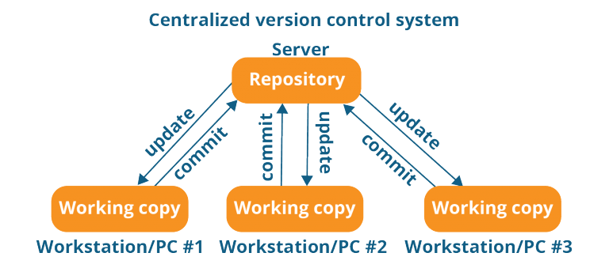
Centralized VCS
The repository in the diagram indicates a central server that could be local or remote which is directly connected to each of the programmer’s workstation.

Slide 30
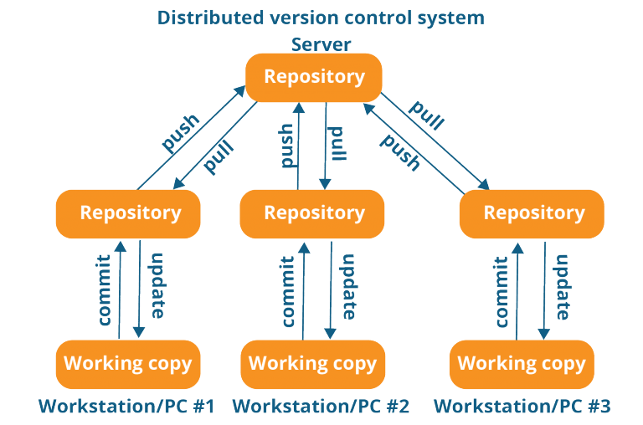
Distributed VCS
These systems do not necessarily rely on a central server to store all the versions of a project file.

Slide 31
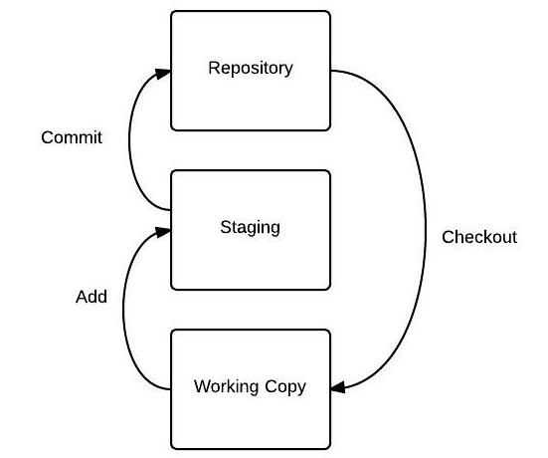
Two - Tree Architecture
You know what a 2 Tree Architecture looks like, interesting to say Git has different one, it is instead powered by 3 Trees! By adding a staging tree in between.

Slide 32
Simple git Workflow
$ git init
$ git add
$ git commit
Create a Repository
Create file in working directory
Staging area
repository
Use full commands to check different stats in git
git status
git show
git log

Slide 33
Connect Local Repository with Server
In a real-world scenario, you may find it easier to first create a Repository on a Git hosting provider (e.g. GitHub or Gitlab ). Then, simply clone it to your local computer. The reason is that they automatically set the remote for you. Meaning that your local and remote repositories are connected by default.
But, in case you have created a repository on your local computer and then want to connect it with a server. Then, run the below command.
$ git remote add [remote_name] [remote_url]
$ git remote add origin [origin name]
To check remote url
$ git remote -v
To name HEAD branch to ‘main’ & push code to remote repository
git branch -M main
-u used to set upstream
git push -u origin main

Slide 34
Connect Local Repository with Server
Scenario with existing remote repository.
$ git init
$ git remote add origin [repo_url]
To name HEAD branch to ‘main’ & push code to remote repository
git branch -M main
git pull origin main
$ git clone [repo url]

Slide 35
.gitignore
A gitignore file specifies intentionally untracked files that Git should ignore. Files already tracked by Git are not affected;
Each line refers to a file or folder to be ignored.
Sample .gitignore file
ssh
testing.py

Slide 36
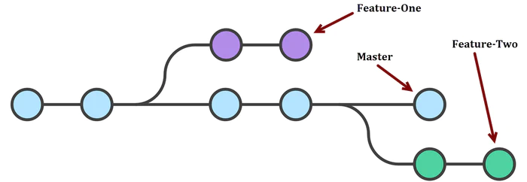
Branches
Git branching model is similar to that of a Tree with branches. They are particularly useful when you want to add a new feature or fix a bug in your project.
Basically, you create a new branch to separately test something. When your work is done then simply merge it with your main branch (i.e. master). In case, you don’t like the new idea then you can easily discard the changes without affecting the project.

Slide 37
Branches
Branch Naming Strategies
username/description
username/workitem
You can name a branch to indicate the branch’s function, like a feature, bug fix, or hotfix:
bugfix/description
feature/feature-name
hotfix/description
How to Create a Branch in Git
Option 1: Creating a Branch
creating a branch this way does not automatically switch to the new branch.
git branch <branch name>
git branch
Option 2: Creating a Branch using Checkout
If you want to create a branch and checkout the branch simultaneously.
git checkout -b <branch name>
git branch

Slide 38
Branches
How to Create a Branch in Git
Option 1: Creating a Branch
creating a branch this way does not automatically switch to the new branch.
git branch <branch name>
git branch
Option 2: Creating a Branch using Checkout
If you want to create a branch and checkout the branch simultaneously.
git checkout -b <branch name>
git branch
Option 3: Creating a Branch from a Commit
You can create a branch from a previous commit on an existing branch. Before creating the branch, you need the SHA-1 identifier of the commit.
git log
git branch <branch name> <identifier>
Option 4: From another Branch
This example shows creating the feature4 branch from the develop branch.
git checkout -b feature4 develop

Slide 39
Branches
Merge Branches
git checkout main
git merge <branch name>

Slide 40
Thanks!
Any questions?
You can find me @

